Slide 1
TB/HIV model update
March 26, 2021

Slide 2
Initialize Population
With warm up period

Slide 3
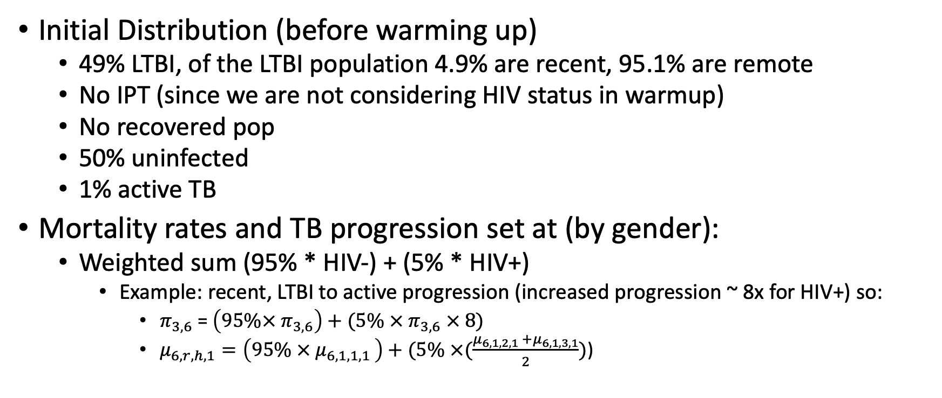
Initialize Population (with warm up period) Only including TB progression and gender
Initial Distribution (before warming up)
49% LTBI, of the LTBI population 4.9% are recent, 95.1% are remote
No IPT (since we are not considering HIV status in warmup)
No recovered pop
50% uninfected
1% active TB
Mortality rates and TB progression set at (by gender):
Weighted sum (95% * HIV-) + (5% * HIV+)
Example: recent, LTBI to active progression (increased progression ~ 8x for HIV+) so:
$π_{3,6}$ = $\left(95\%× π_{3,6}\right)+(5\% × π_{3,6} × 8)$
$μ_{6,r,h,1}=\left(95\% × μ_{6,1,1,1 }\right)+(5\% ×(\frac{μ_{6,1,2,1 }+μ_{6,1,3,1}}{2})$)

Slide 4
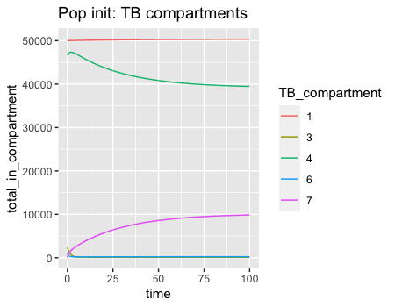
All TB compartments overtime in warmup period

Slide 5
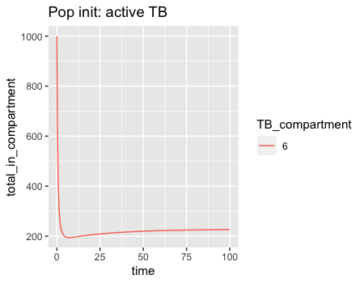
Active TB overtime in warmup period

Slide 6
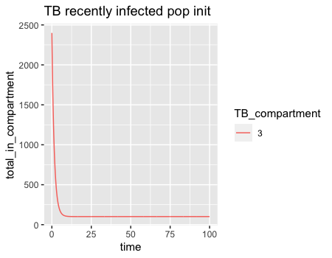
Recent TB overtime in warmup period

Slide 7
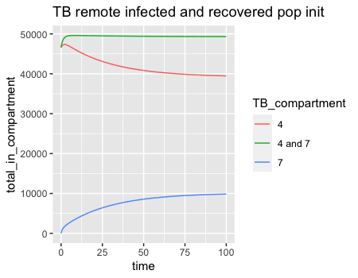
LTBI, remote, and recovered change in pop
TB_compartment(s) | t=0 | t=100 | difference
4 | 46594 | 39465 | -7129
7 | 0 | 9855 | 9855
4 and 7 | 46594 | 49320 | 2726

Slide 8
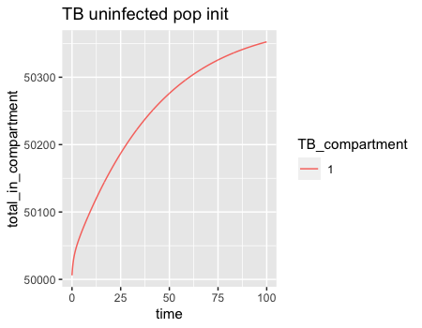
Uninfected overtime in warmup period
TB_compartment | t=0 | t=100 | difference
1 | 50000 | 50,276 | 276

Slide 9
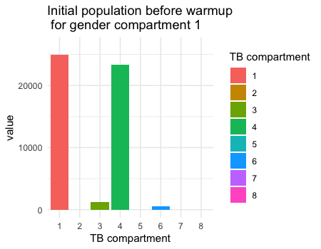
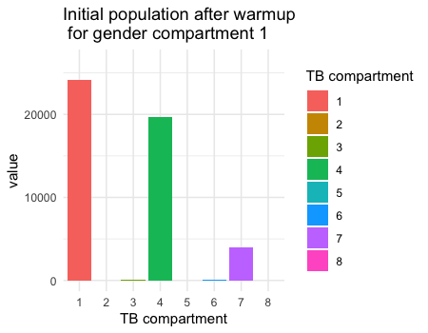
Before and after warmup: Males

Slide 10

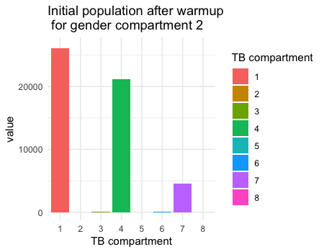
Before and after warmup: Females

Slide 11
Model state raw outputs

Slide 12
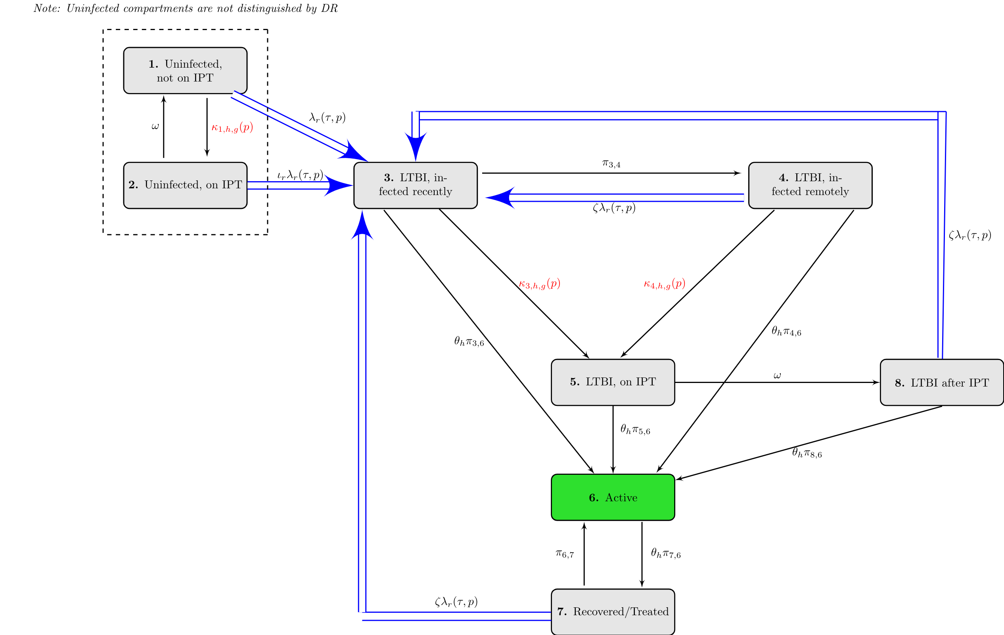
Description of TB Transitions

Slide 13
All TB compartments overtime 1990-2017 (after warmup)

Slide 14
Active TB 1990-2017 (after 100-year warmup) Summed over all genders, DR and HIV compartments

Slide 15
Recently Infected

Slide 16
Uninfected

Slide 17
Latently Infected and Recovered

Slide 18
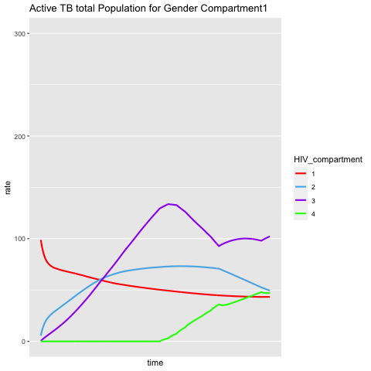
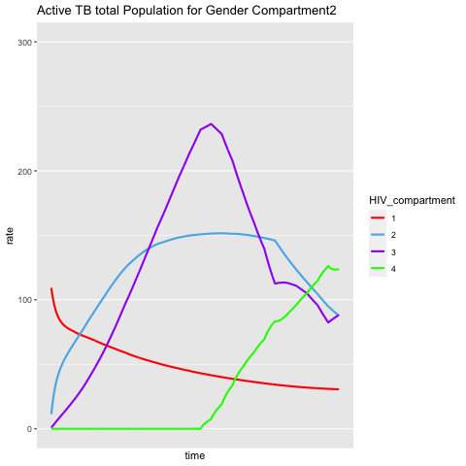
Active TB 1990-2017 (after 100-year warmup) By HIV status, Gender
Males
Females

Slide 19
Calibration outputs
Comparing to GBD

Slide 20
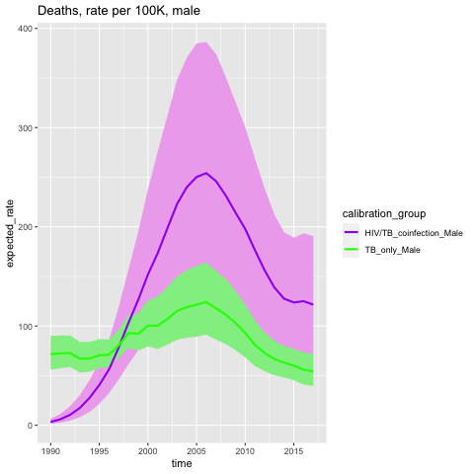
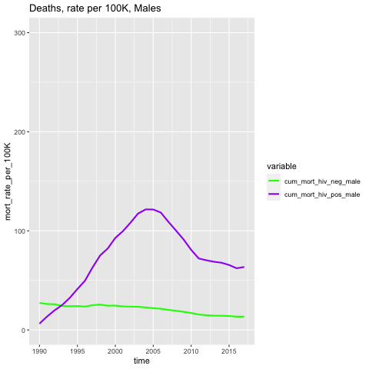
TB only
TB/HIV coinfection

Slide 21
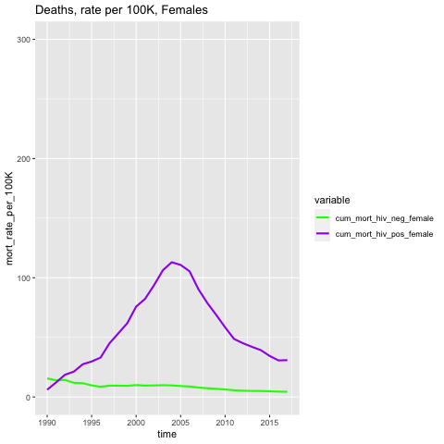
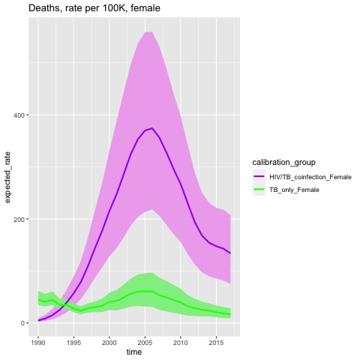
TB only
TB/HIV coinfection

Slide 22
Calculated parameters that change overtime from 1990-2017

Slide 23
ART initiation rates

Slide 24
ART initiation from 1990-2017
Are there a higher proportion of PLWH initiating with lower CD4 counts?

Slide 25
Mortality Rates

Slide 26
Non-disease specific mortality

Slide 27
Mortality rate assumptions
HIV increase from base:
HIV-, 1x (no increase)
HIV+, CD4 <= 200, not on ART: 5x
HIV+, CD4 > 200, not on ART: 10x
HIV+, on ART: 1.2x
TB increase from HIV-related mortality:
HIV -, 20x
HIV+, CD4 <= 200, not on ART: 10x (50x total)
HIV+, CD4 > 200, not on ART: 10x (100x total)
HIV+, on ART: 25x (30x total)

Slide 28
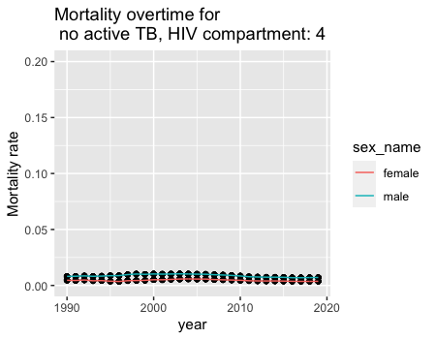
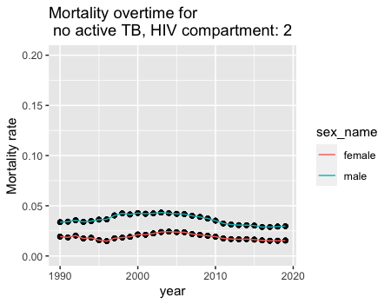
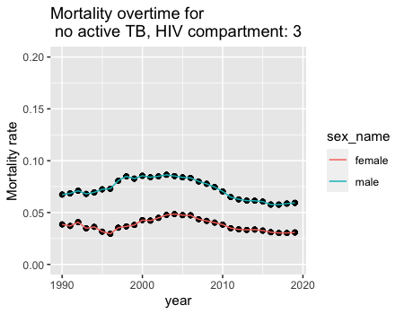
Mortality rates (no active TB)

Slide 29
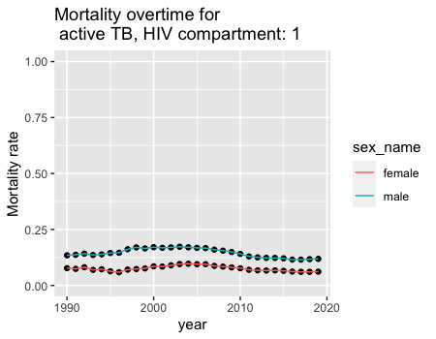
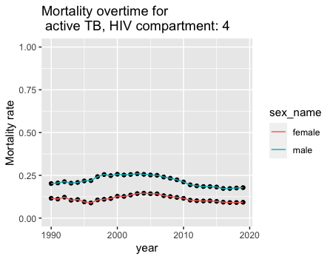
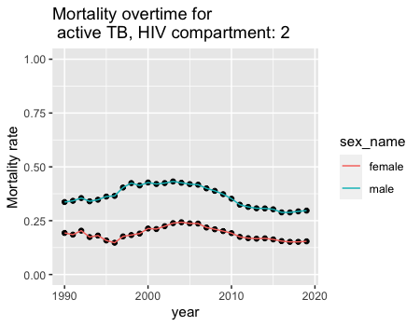
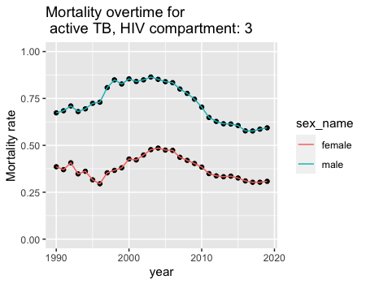
Mortality rates (active TB)

